Slide 1
Cache architecture improve computer performance with cache
I4GIC

Slide 2
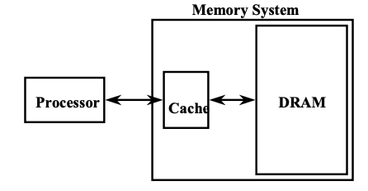
Motivation for caches
Motivation:
Large memories (DRAM) are slow
Small memories (SRAM) are fast
Make the average access time small by:
Servicing most accesses from a small, fast memory.
Reduce the bandwidth required of the large memory

Slide 3
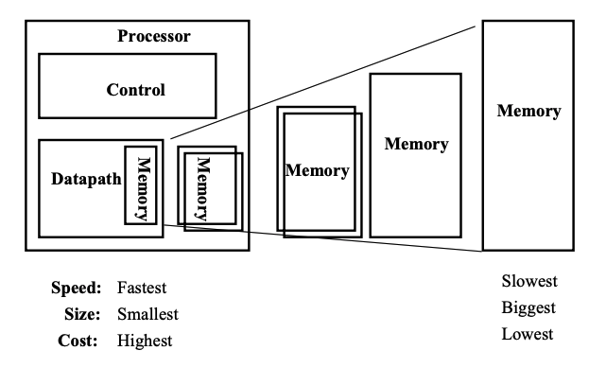
An expanded view of the memory system

Slide 4
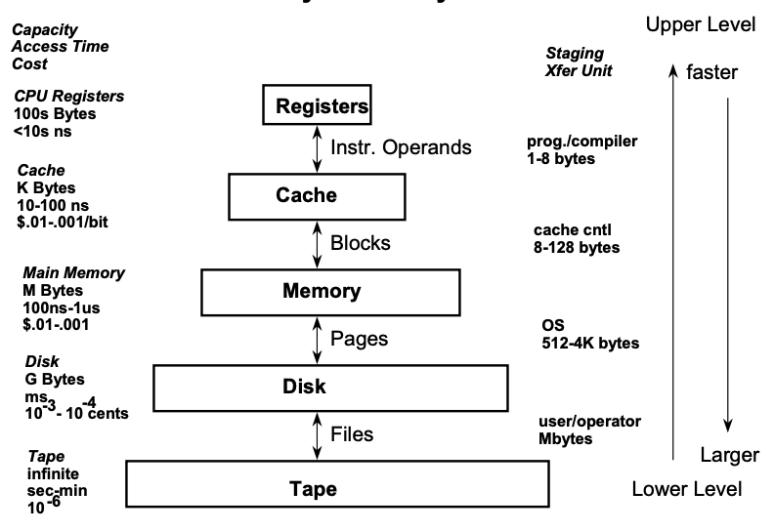
Levels of the memory hierarchy

Slide 5
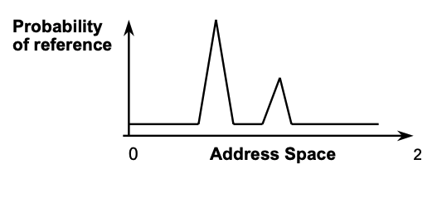
The principle of locality
What are the principles of Locality?

Slide 6
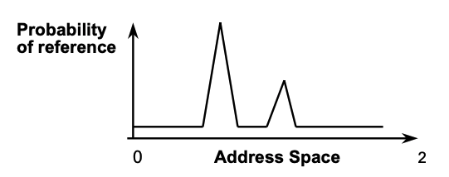
The principle of locality
The Principle of Locality:
Program access a relatively small portion of the address space at any instant of time.
Example: 90% of time in 10% of the code
Two Different Types of Locality:
Temporal Locality (Locality in Time): If an item is referenced, it will tend to be referenced again soon.
Spatial Locality (Locality in Space): If an item is referenced, items whose addresses are close by tend to be referenced soon.

Slide 7
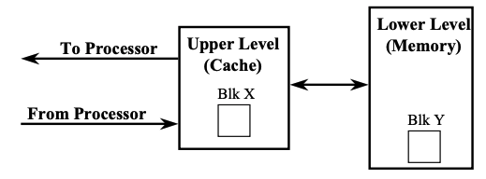
Memory hierarchy: principle of operation
At any given time, data is copied between only 2 adjacent levels:
Upper Level (Cache) : the one closer to the processor
- Smaller, faster, and uses more expensive technology
Lower Level (Memory): the one further away from the processor
- Bigger, slower, and uses less expensive technology
Block:
The minimum unit of information that can either be present or not present in the two level hierarchy

Slide 8
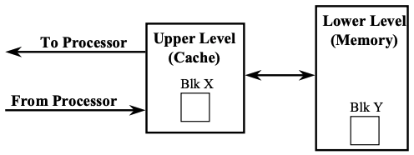
Memory hierarchy: terminology
Hit: data appears in some block in the upper level (example: Block X)
Hit Rate: the fraction of memory access found in the upper level
Hit Time: Time to access the upper level which consists of RAM access time + Time to determine hit/miss
Miss: data needs to be retrieve from a block in the lower level (Block Y)
Miss Rate = 1 - (Hit Rate)
Miss Penalty = Time to replace a block in the upper level + Time to deliver the block the processor
Hit Time << Miss Penalty

Slide 9
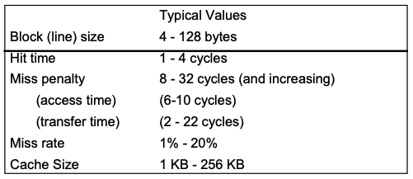
Basic terminology: typical values

Slide 10
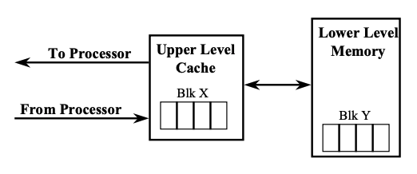
How does cache work?
Temporal Locality (Locality in Time): If an item is referenced, it will tend to be referenced again soon.
Keep more recently accessed data items closer to the processor
Spatial Locality (Locality in Space): If an item is referenced, items whose addresses are close by tend to be referenced soon.
Move blocks consists of contiguous words to the cache

Slide 11
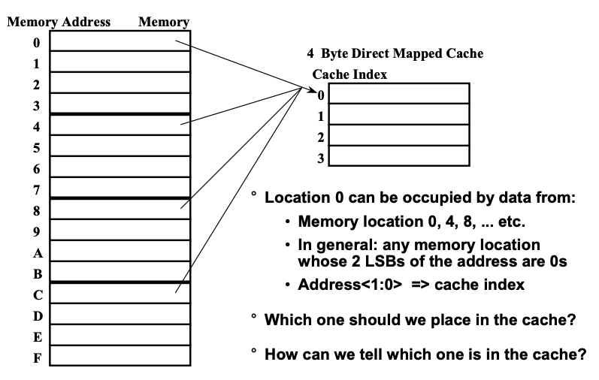
The simplest cache: direct mapped cache

Slide 12
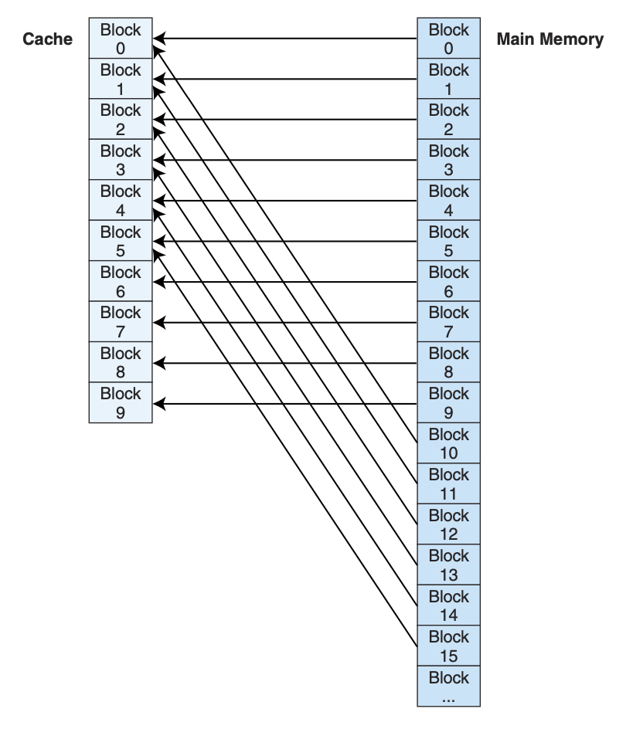
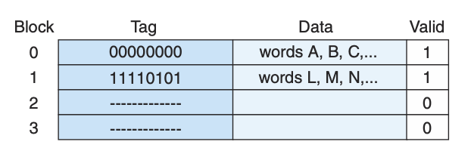
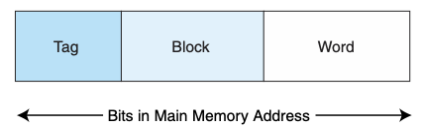
Direct Mapped Cache
Direct mapped cache assigns cache mappings using a modular approach. Because there are more main memory blocks than there are cache blocks, it should be clear that main memory blocks compete for cache locations.
In direct mapped cache, a block of main memory has a specific location in cache.
For example, if cache contains 10 blocks, then main memory block 0 maps to cache block 0, main memory block 1 maps to cache block 1, . . . , main memory block 9 maps to cache block 9, and main memory block 10 maps to cache block 0

Slide 13
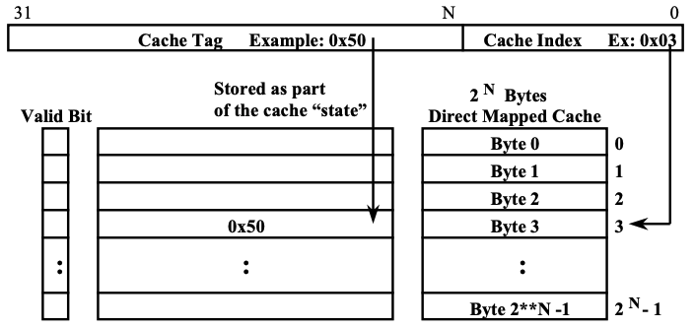
Cache tag and cache index
Assume a 32-bit memory (byte ) address:
A 2^{N} bytes direct mapped cache:
- Cache Index: The lower N bits of the memory address
- Cache Tag: The upper (32 - N) bits of the memory address

Slide 14
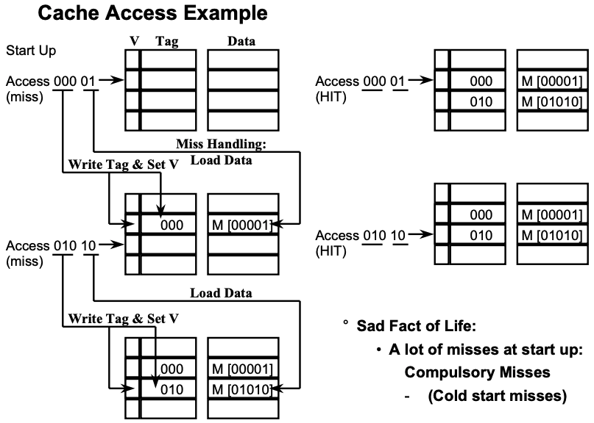

Slide 15
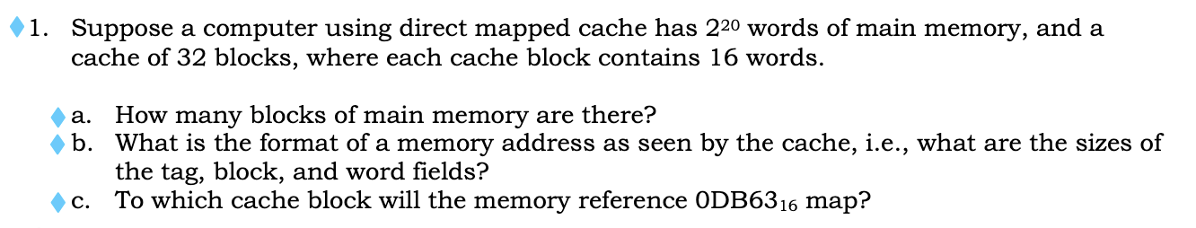
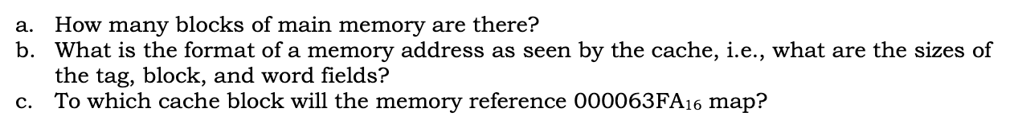
exercise

Slide 16
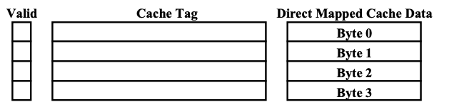
Definition of a cache block
Cache Block: the cache data that has in its own cache tag
Our previous “extreme” example:
4-byte Direct Mapped cache: Block Size = 1 Byte
Take advantage of Temporal Locality: If a byte is referenced, it will tend to be referenced soon.
Did not take advantage of Spatial Locality: If a byte is referenced, its adjacent bytes will be referenced soon.
In order to take advantage of Spatial Locality: increase the block size

Slide 17
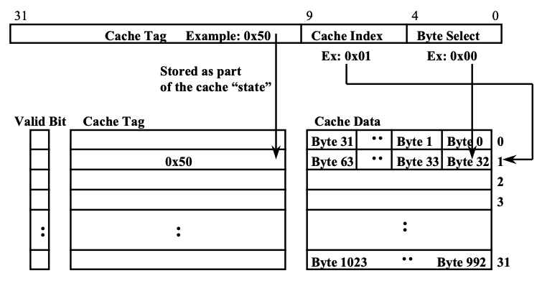
Example
1 KB Direct Mapped Cache with 32 B Blocks
For a 2^{N} byte cache:
The uppermost (32 - N) bits are always the Cache Tag
The lowest M bits are the Byte Select (Block Size = 2^{M})

Slide 18
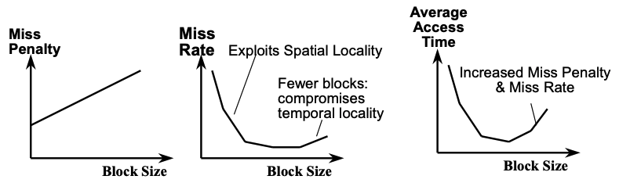
Block size tradeoff
In general, larger block size take advantage of spatial locality BUT:
Larger block size means larger miss penalty:
- Takes longer time to fill up the block
If block size is too big relative to cache size, miss rate will go up
Average Access Time = Hit Time x (1 - Miss Rate) + Miss Penalty x Miss Rate

Slide 19
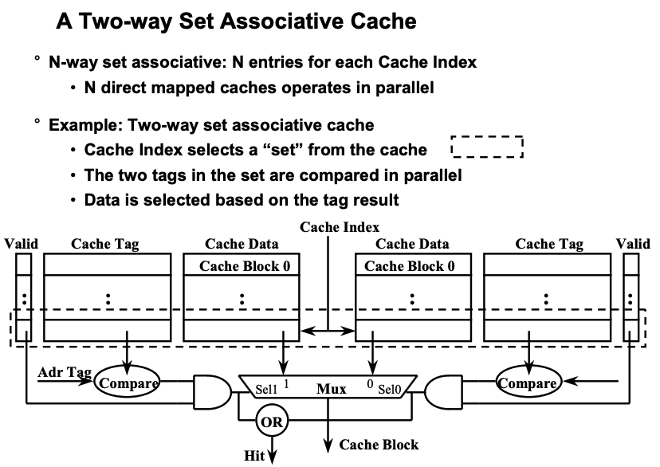

Slide 20
